Slide 1
Game Studio 1
Fall 2016 - Week 1
m@ boch — mattboch@nyu.edu
Zijian “Zed” Zhou - zz1322@nyu.edu

Slide 2
Today’s class
Introductions
Course overview
Technical setup
First assignment

Slide 3
Class philosophy
Every part of a game is design
Working alone, mostly
Try a bit of everything
Two engines, two flavors of development (why?)
Learn to SCOPE

Slide 4
This class
...is not a reading or discussion class
...is a class where you learn by making stuff
Each of you has different skills
In this class you do a bit of everything
If you have made games before, this is a chance to experiment outside your wheelhouse

Slide 5
In every class...
Tuesdays: critique, lessons, exercises
Thursdays: work time, playtesting

Slide 6
Critique section - starts A
A
Anuva
Corey
David
Kit
Longxiao
Morgan
Robert
Wei
B
Hosni
Shelly
Jenna
Cunbo
Shiyun
Andrew
Christopher
Zhaopeng

Slide 7
The things you’ll make
Modify a simple 2D game in Phaser (starts today) - 2 weeks
Make your own Phaser game - 3 weeks
Modify a game in Unity - 2 weeks
Make your own Unity game - 3 weeks
Final project in pairs - 3 weeks

Slide 8

Last year’s games
Burgess Voshell - DYG

Slide 9
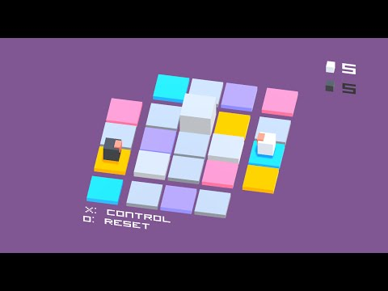
Lily Ling - Box Fighter

Slide 10

Denver Coulson - Infiniball

Slide 11
What makes a good videogame?

Slide 12
Grading
I’m looking for games that are surprising, OR experimental, OR affecting, OR well-made
This is your chance to broaden your skillset
I will reward non-artists who work hard on art, non-programmers who work hard on code, and non-writers who work on writing.

Slide 13
Grading breakdown
Critique and participation: 20%
Phaser warmup: 10% (pass/fail)
Phaser project: 20%
Unity warmup: 10% (pass/fail)
Unity project: 20%
Final project: 20%

Slide 14
The assignment
Modify the game at
http://gcserver.magnet.nyu.edu/~yourusername/introgame
Try to only use the functions that are already in there, even if you’re a programmer!
Make it as different as you can.
Focus on learning and understanding
Due in 2 weeks, demo next week!

Slide 15
Some foundational vocabulary

Slide 16
Engine
A piece of software that enables game creation.

Slide 17
Asset
An image, sound, 3d model, animation or other piece of game content, often created outside of the game engine.

Slide 18
Sprite
2D imaged-based game object.

Slide 19
GUI / UI
Graphical User Interface.

Slide 20
Playtesting
Testing your game by observing others playing it.

Slide 21
Iteration
A process of continual refinement.

Slide 22
Bug
Unintended behavior resulting from errors in code.

Slide 23
Polish
Visual & auditory refinement beyond what’s necessary to communicate the game’s concept / story / mechanics.

Slide 24
Backup
A copy stored elsewhere for safe-keeping
Notes:
We’ll do this for you so long as you’re on the Phaser server, at 4am. But you’re responsible for keeping one of these more generally. We’ll be understanding if the situation is dire, but don’t be careless & risk losing great work!

Slide 25
Game
;)

Slide 26
How is videogame creation structured?

Slide 27
Concept Development
Prototyping
Pre-Production
Production
Alpha
Beta
Release
Notes:
This is how a standard medium to large game might be broken up into production phases.
Game production timelines take a bit from filmmaking and a bit from software development. Concept development & prototyping is like script development & test shots. Pre-production is when you figure out what you need to do. Production is when you do it. Alpha & Beta are largely for working out bugs & usability issues. These exist because coding is unpredictable & even the most experienced engineers generate tons of bugs. So don’t be embarrassed or discouraged when you do too!
Larger games often have hard boundaries between the phases, and indie games that are not self-published are often subject to boundaries like these based on agreements with publishers.
Continuous, iterative dev is also increasingly prevalent, particularly for online-only games like MMO’s & MOBAs, as well as early access games.

Slide 28
Prototyping
Production
Beta
Release
Notes:
But plenty of smaller games have more simplified processes, where prototyping might seamlessly transition into production. As the game is closer to completion, you might share it with a dozen or more friends to assist you in identifying bugs & issues, an informal beta, followed by release.
In this class we’ll be mostly making prototypes, but you should ensure you reserve enough time for a brief beta before you present your game in class. “Critical Path” bugs that prevent you from presenting your game are unacceptable.

Slide 29
2 “jokes” about the creative process.

Slide 30

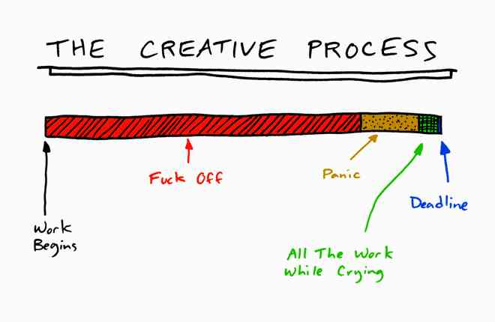
Notes:
As independent makers, it’s important that you find your own sustainable working style. The creative process has inevitable ups & downs, be prepared for these and over time you’ll learn to identify an “I am crap” moment as a something that will pass.
This isn’t going to be easy, but you shouldn’t let it become soul destroying. A huge part of that is on your & your ability to manage your time. Don’t go through all 6 steps in one night! Lots of creative folks struggle with motivation & procrastination. Support each other, reach out when you need help, keep yourself honest.
You’ll need to be able to hold yourself accountable to your commitments to get the maximum benefit from this program. You’ll get better and better at predicting the time various tasks will take as you gain experience.
Rule of thumb: it’s best to keep your scope tight so that you can deliver something focused & high quality. This is true for most every game (and many creative practices outside of games).

Slide 31
Phaser
Phaser: a modern HTML5 browser game engine based on Flixel
A ‘code only’ platform for making games
www.phaser.io
http://phaser.io/docs
http://phaser.io/examples
Notes:
Explain Why

Slide 32
How HTML5 engines work
Your browser loads the index.html file
The HTML file tells the browser to load javascript code from .js files
It also makes a container in the page, where the game can be drawn
First it loads phaser.js, which holds all the engine code
Then it loads game.js, which holds your game
game.js creates a ‘canvas’ and puts it in the container
game.js may load additional files (like images)

Slide 33
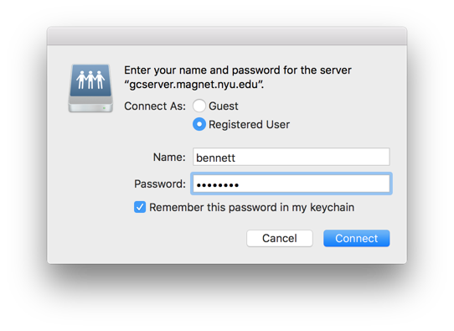
Connect to the server: Mac
Mac:
Go to Finder and hit ⌘-K
Type smb://gcserver.magnet.nyu.edu/username
Choose ‘Registered User’
Put in your username and password

Slide 34
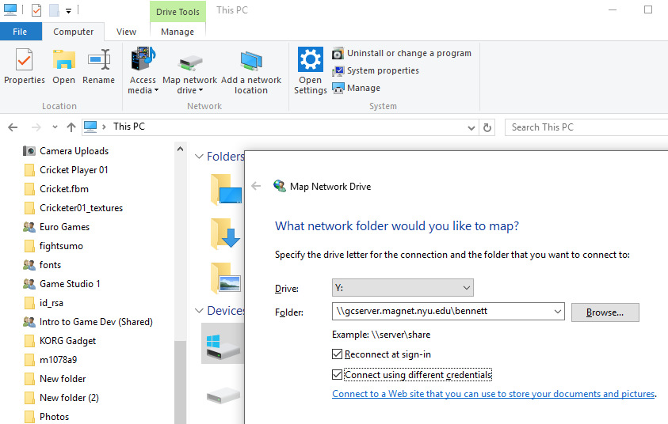
Connect to the server: PC
Windows:
In Explorer, go to ‘This PC’
Click ‘Map Network Drive’
Enter \\gcserver.magnet.nyu.edu\username (note backward slashes)
Check ‘different credentials’
Put in your username and password

Slide 35
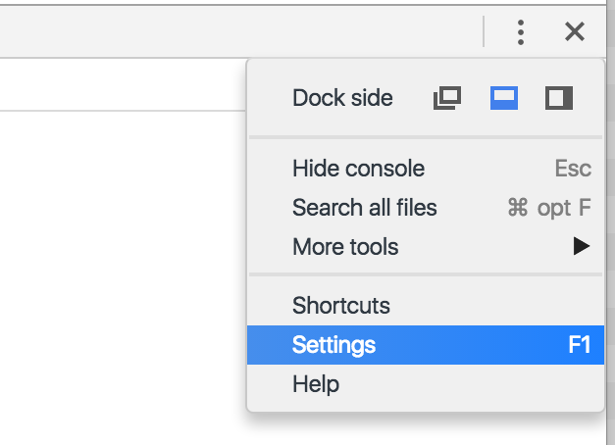
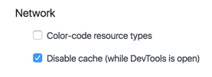
Test the game!
Open Chrome
First let’s set it up to make sure that it always reloads your work. Open the dev tools:
Mac: ⌘-Alt-J, Win: Ctrl-Shift-I or F12

Slide 36
Test the game
Go to
http://gcserver.magnet.nyu.edu/~username/introgame
And check to see if it works!
Now let’s load it up in Sublime Text. Find the file called ‘game.js’ in your server folder and make a change.

Slide 37
Local server: Mongoose
For when you don’t have internet access, or if the server is slow. (But please put your game on the server every day)
Make a local backup of the game folder
Start the application
Right-click the taskbar icon, choose ‘Edit configuration’
Edit the ‘Document Root’ to point to your local copy of your game
Restart Mongoose

Slide 38
Explaining the code

Slide 39
The Rules
Even if you’re an experienced programmer, try to stick to the Phaser functions already demonstrated in this intro project
Make it as different as you can while still making sure it works.
Getting stuck with code is no excuse: Find me, your TA, Matt Parker, or code help desk

Slide 40
Homework
Make some changes to the game! Have something to show next week. Undo anything that doesn’t work, and keep lots of backups!
Install Adobe Photoshop (see Kevin Spain for a key if you don’t have one)

